Slide 1
Audio Devices Offset Spec Comparison
ATK SMD Team

Slide 2
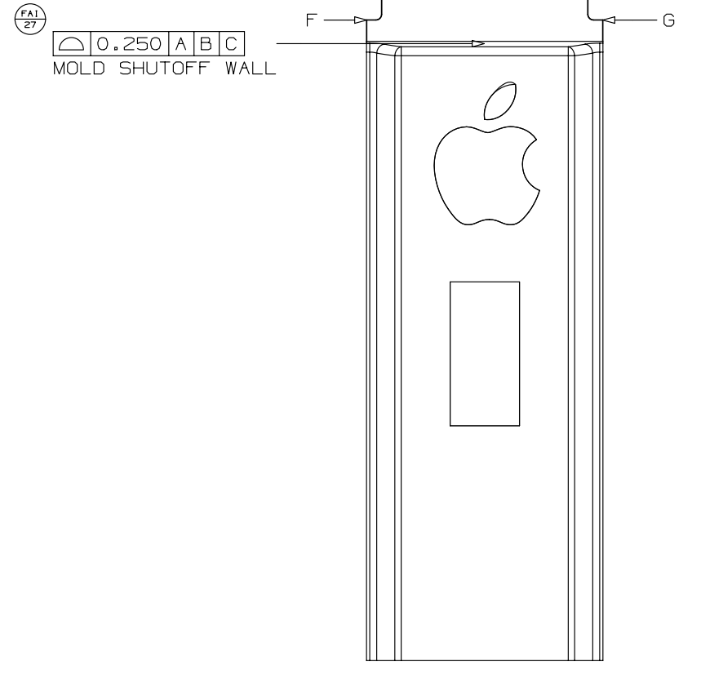
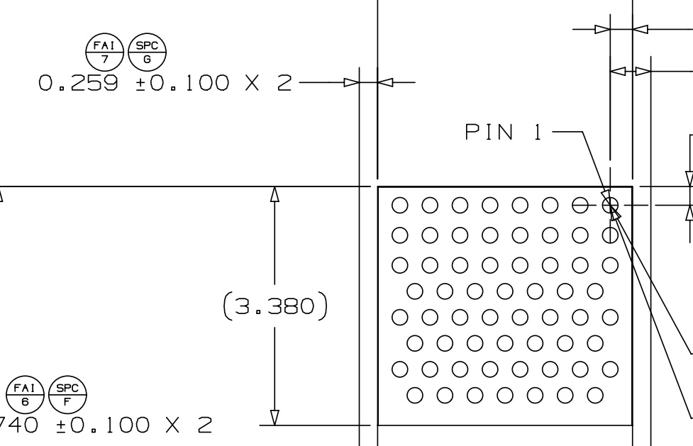
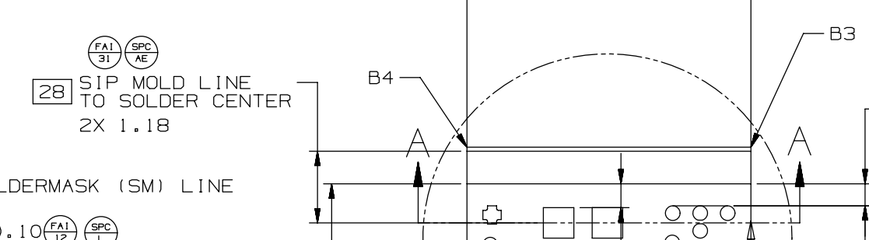
Monaco Marlin FAI Spec
MCO Spec & Amkor Internal Control(Pemtron) Spec Comparison
Marlin X-Offset Spec : Doesn’t have any FAI Spec
Marlin Y-Offset Spec : FAI 7
Monaco X-Offset Spec : FAI 31
MCO USL : Doesn’t exist
MCO USL : +100um
Pemtron USL +200um
Pemtron USL : +100um
MCO USL : +125um
Pemtron USL : +90um
Target
Target : 259um
Target : 1.18mm
Pemtron LSL : -100um
Pemtron LSL : -90um
Pemtron LSL -200um
MCO LSL : -100um
MCO LSL : -125um
MCO LSL : Doesn’t exist

